Slide 1
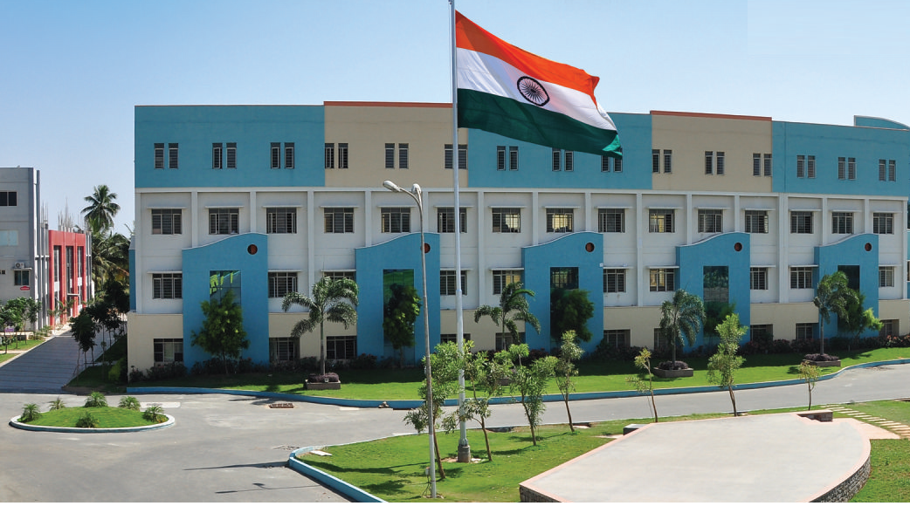
SRI ESHWAR COLLEGE OF ENGINEERING ACADEMIC YEAR: 2022-23 DEPARTMENT: MECHANICAL SECTION:A
MINI PROJECT FINAL REVIEW
DATE OF REVIEW: 13/05/2023

Slide 2
DESIGN AND DEVELOPMENT OF HAND GLOVE CONTROLLED WHEEL CHAIR
Guide Name
Mr. Sathish. K
Asst. Prof/ Mech Dept.
Batch Members
Aditya Krishna S
Kamalapuram Mahaboobbasha
Pravin R

Slide 3
PRESENTATION OUTLINE
Introduction
Objective
Methodology
Components
Circuit Diagram
Explanation
Conclusion
Reference

Slide 4
INTRODUCTION
The use of wheelchairs as an aid to individuals with physical disabilities has been an important part of society.
In this project we had developed hand glove controlled wheelchair.
This technology that allows users to more easily and conveniently control their wheelchair with simple hand movements.
This technology is easy to understand by everyone and they can control by their own without others help.

Slide 5
OBJECTIVES
The main objective of the project is to make the control system of wheelchair simple and automatic.
The system is developed for physically challenged people
The project is useful for the physically challenged people to move the wheel chair by their own with the help of hand glove.

Slide 6
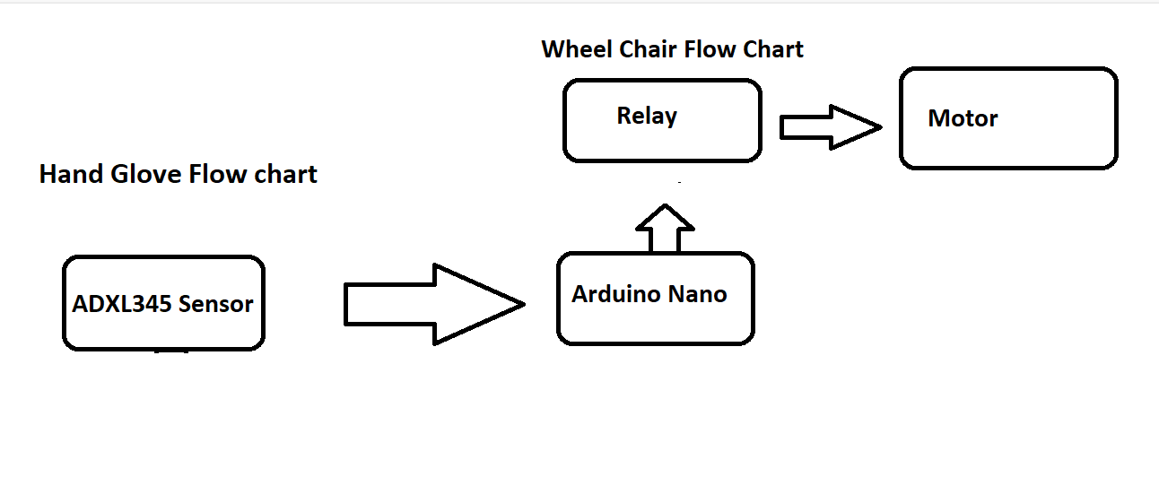
METHODOLOGY

Slide 7
COMPONENTS
Arduino nano(Micro controller)
Accelerometer sensor(ADXL345)
Relay
Battery 12V 9Amh
Battery 9V
Wheel Chair
Hand Glove

Slide 8
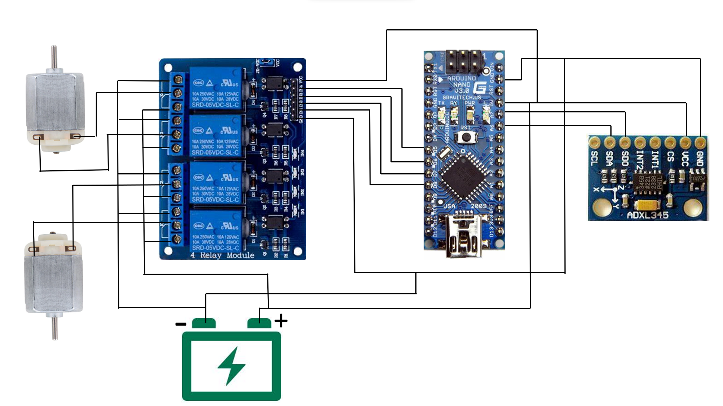
CIRCUIT DIAGRAM
Arduino NANO
4 Relay Module
Motor
Accelerometer Sensor
Battery

Slide 9
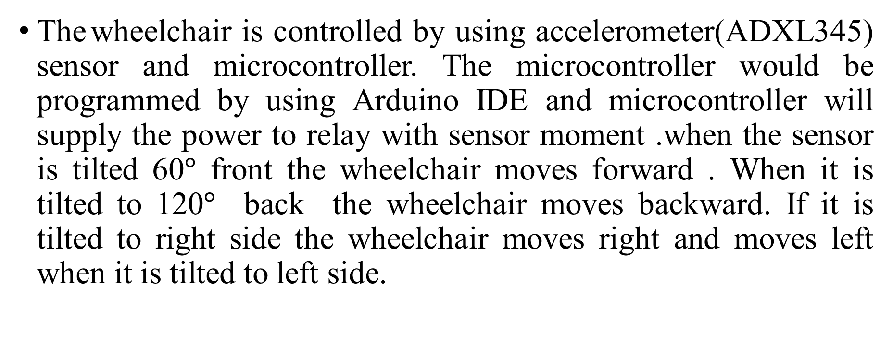
EXPLANATION
The wheelchair is controlled by using accelerometer(ADXL345) sensor and microcontroller. The microcontroller would be programmed by using Arduino IDE and microcontroller will supply the power to relay with sensor moment .when the sensor is tilted 60$°$ front the wheelchair moves forward . When it is tilted to 120$°$ back the wheelchair moves backward. If it is tilted to right side the wheelchair moves right and moves left when it is tilted to left side.

Slide 10

Code

Slide 11
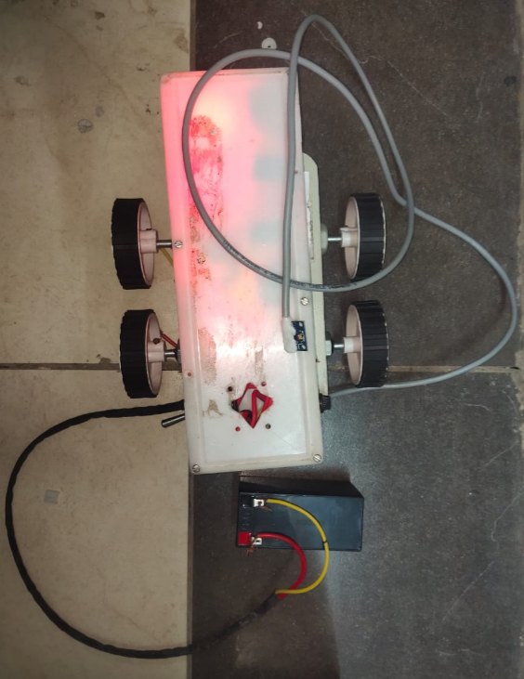
PROTOTYPE
In this prototype, Mini car chassis was employed to study.
Prototype is being completed & the test was successful.

Slide 12
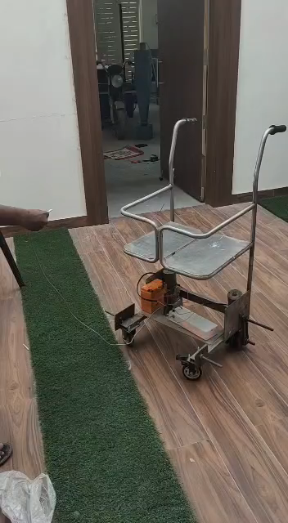
WORKING MODEL

Slide 13
CONCLUSION
This project has explored the possibilities of enhanced mobility using hand glove controlled wheelchairs.
The proposed design utilizes a glove-based sensing system and an embedded microcontroller to control the wheelchair’s speed, direction, and other features.
It was shown that wheelchair users had improved mobility with the proposed design, and that it was also intuitive to use.

Slide 14
REFERENCE
1.Perez, A.J., Siddiqui, F., Zeadally, S. and Lane, D., 2022. A Review of IoT Systems to Enable Independence for the Elderly and Disabled Individuals. Internet of Things, p.100653.
2.Avutu, S.R., Paul, S. and Reddy, B.V., 2023. A review on wheelchair and add-in devices design for the disabled. International Journal of Biomedical Engineering and Technology, 41(1), pp.35-59.
3.Motahar, T. and Wiese, J., 2022. A Review of Personal Informatics Research for People with Motor Disabilities. Proceedings of the ACM on Interactive, Mobile, Wearable and Ubiquitous Technologies, 6(2), pp.1-31.
4.Jiang, L., Luo, C., Liao, Z., Li, X., Chen, Q., Jin, Y., Lu, K. and Zhang, D., 2023. SmartRolling: A human–machine interface for wheelchair control using EEG and smart sensing techniques. Information Processing & Management, 60(3), p.103262.

Slide 15
THANK YOU

